Slide 1
In the name of Allah Kareem, Most Beneficent, Most Gracious,
the Most Merciful !

Slide 2
RESEARCH METHOD
LECTURE: 4

Slide 3
Introduction to SPSS
Before further processing of the data we should get to know about SPSS software first .
SPSS
SPSS stands for “statistical package for social sciences”. It is basically used for the analysis of quantitative data .
How to open SPSS
Start Menu
Programs
SPSS Inc.
SPSS 16.0

Slide 4
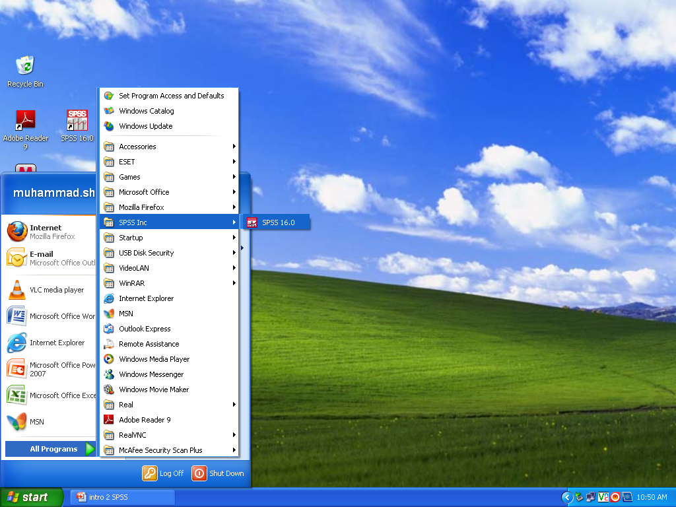

Slide 5
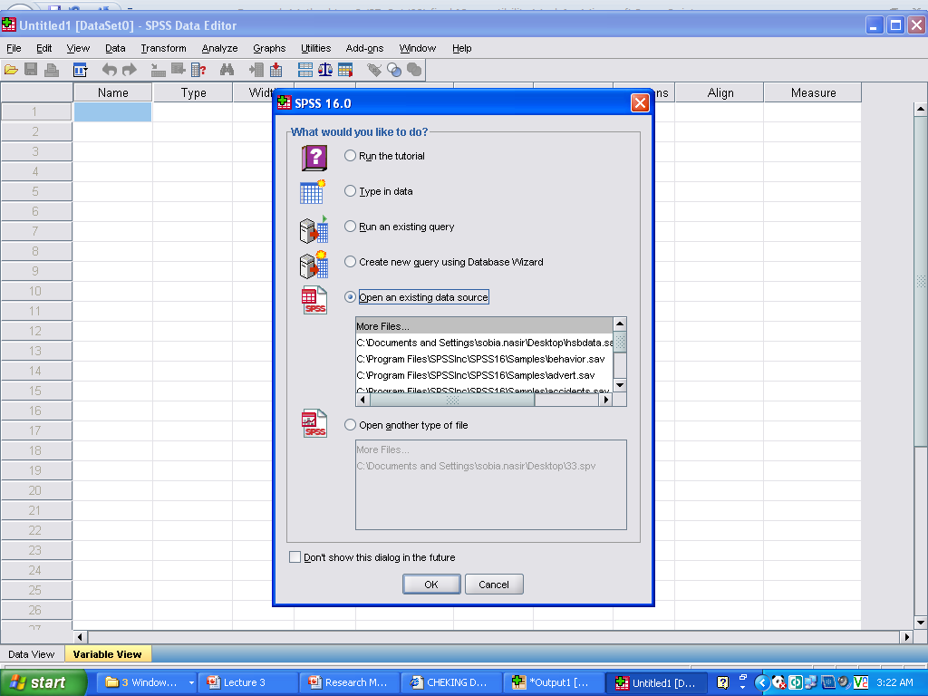
Welcome window SPSS 16.0

Slide 6
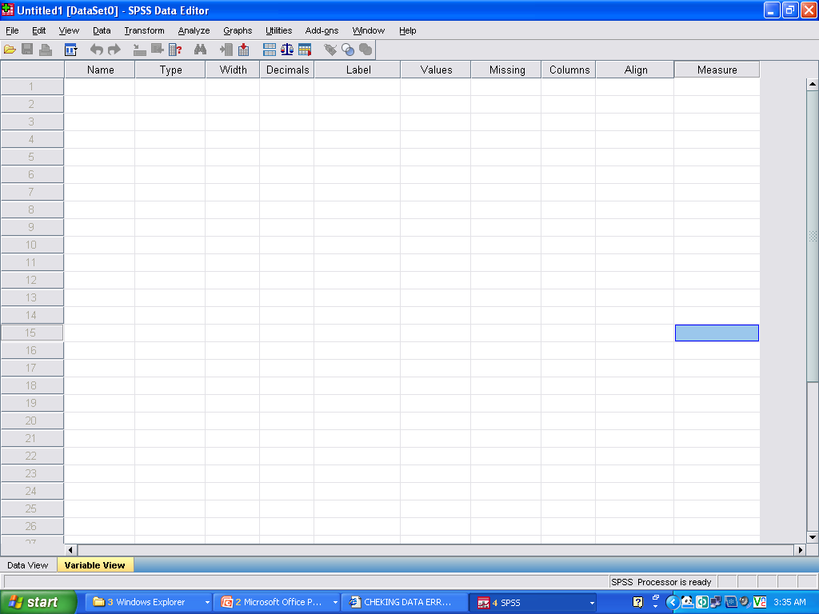
SPSS Interface
Title Bar
Menu Bar
Tool Bar
Variable definition criteria
Serial Number / Cases
Work sheet
SPSS Views

Slide 7
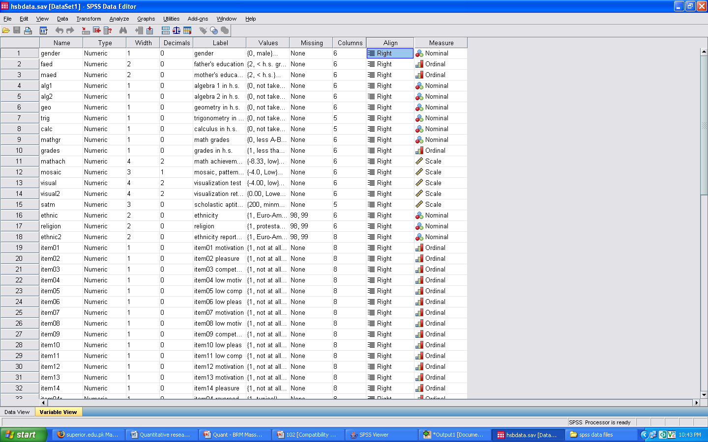

Slide 8
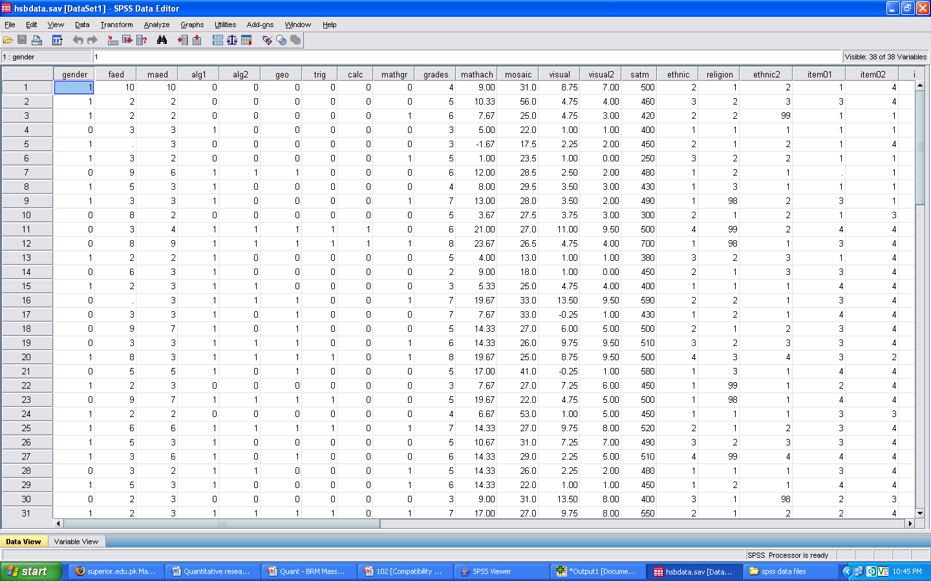
Data Entry
After defining the variables enter the data in data view for each case (row wise) against each variable (column wise)

Slide 9
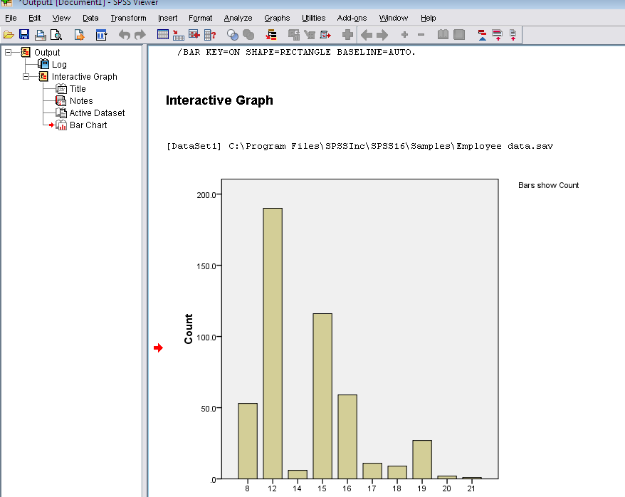

Slide 10
Data Processing
After collecting the data, data processing is started that involves
Data coding
Defining the variables
Data entry in the software
Checking for error

Slide 11
SAMPLE QUESTIONNAIRE
Please circle or supply your answer ID_________ SD SA I would recommend this course to other students 1 2 3 4 5 I worked very hard in this course 1 2 3 4 5 My college is : Arts & sciences___ _ Business____ Engineering____ My gender is M F My GPA is _____________ For this class, I did: (Check all that apply The reading The homework Extra credit

Slide 12
Coding
Coding is the process of assigning numbers to the values or levels of each variable.
Rules of Coding
All data should be numeric.
Each variable for each case or participant must occupy the same column.
All values (codes) for a variable must be mutually exclusive.
Each variable should be coded to give maximum information.
For each participant, there must be a code or value for each variable.
Apply any coding rule consistently for all participants.
Use high numbers (values or codes) for the “agree,” “good,” or “positive” end of a variable that is ordered

Slide 13
Defining the variables
In SPSS first of all the variables are defined in variable view
This includes
Name of the variable (Short without space)
Type (Numeric, String)
Width (8, 10, etc)
Decimals (2, 3, 5 etc)
Label (Full name of the variable)
Values (answer categories with codes)
Missing (blank, multiple, wrong answers)
Columns (6, 8, 10 etc)
Align (Left, right, centre)
Measure (Nominal, ordinal, scale)

Slide 14
THANK YOU
SUPERIOR GROUP OF COLLEGES
14

