Slide 1
Quantitative Techniques
Inferential Statistics

Slide 2
INFERENTIAL STATISTICS

Slide 3
Lesson Objectives
After studying this session you would be able to
Understand and infer results from data in order to answer the associational and differential research questions using different parametric and non parametric tests.
understand implement and interpret the chi-square, phi and cramer’s V
understand, implement and interpret the correlation statistics
understand, implement and interpret the regression statistics
understand, implement and interpret the T-test statistics

Slide 4
Lesson Outline
Non parametric test.
Chi square /Fisher exact
Phi and cramer’s v
Kendall tau-b
Eta
Parametric test
Correlation
Pearson correlation
Spearman correlation
Regression
Simple regression
Multiple regression
T-Test
One-sample T-test
Independent sample T-test
Paired sample T-test

Slide 5
Correlation
Correlation is a statistical process that determines the mutual (reciprocal) relationship between two (or more) variables which are thought to be mutually related in a way that systematic changes in the value of one variable are accompanied by systematic changes in the other and vice versa.
It is used to determine
The existence of mutual relationship that is defined by the significance (p) value.
The direction of relationship that is defined by the sign (+,-) of the test value
The strength of relationship that is defined by the test value
Correlation Coefficient (r)
The correlation coefficient measures the strength of linear relationship between two or more numerical variables. The value of correlation coefficient can vary from -1.0 (a perfect negative correlation or association) through 0.0 (no correlation) to +1.0 (a perfect positive correlation). Note that +1 and -1 are equally high or strong

Slide 6
Correlation
Assumptions and conditions for Pearson
The two variables have a linear relationship.
Scores on one variable are normally distributed for each value of the other variable and vice versa.
Outliers (i.e. extreme scores) can have a big effect on the correlation.

Slide 7
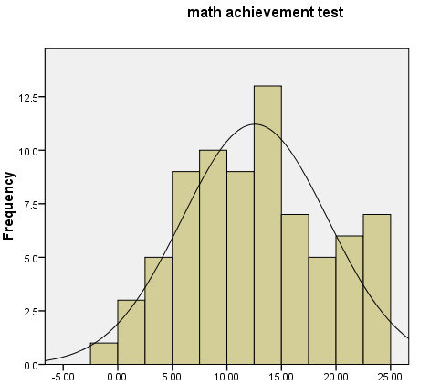
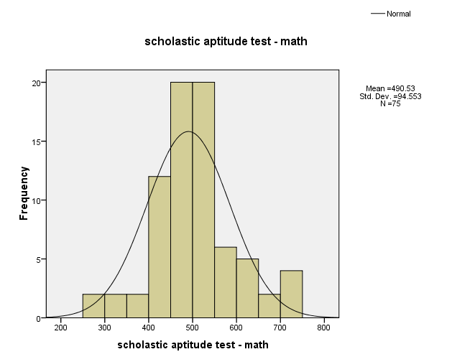
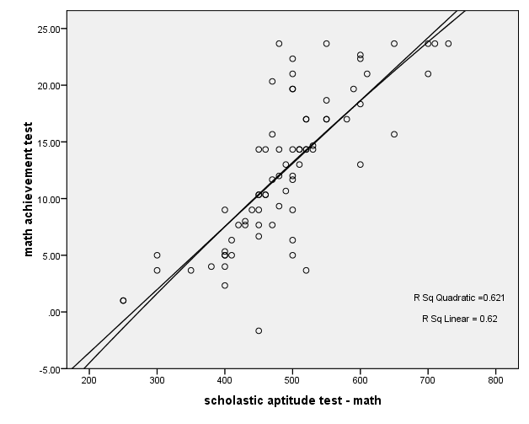
Correlation
Checking the assumptions for Pearson Correlation
The assumptions for correlation test are checked through normal curve (normality assumption) and the scatter plot (linearity assumption)
Statistics
 |  | math achievement test | scholastic aptitude test - math
N | Valid | 75 | 75
 | Missing | 0 | 0
Skewness |  | .044 | .128
Std. Error of Skewness |  | .277 | .277

Slide 8
Correlation
Correlations
 |  | math achievement test | scholastic aptitude test - math
math achievement test | Pearson Correlation | 1 | .788**
 | Sig. (2-tailed) |  | .000
 | N | 75 | 75
scholastic aptitude test - math | Pearson Correlation | .788** | 1
 | Sig. (2-tailed) | .000
 | N | 75 | 75
**. Correlation is significant at the 0.01 level (2-tailed).
Interpretation
To investigate if there was a statistically significant association between Scholastic aptitude test and math achievement, a correlation was computed. Both the variables were approximately normal there is linear relationship between them hence fulfilling the assumptions for Pearson's correlation. Thus, the Pearson’s r is calculated, r= 0.79, p = .000 relating that there is highly significant relationship between the variables. The positive sign of the Pearson's test value shows that there is positive relationship, which means that students who have high scores in math achievement test do have high scores in scholastic aptitude test and vice versa. Using Cohen’s (1988) guidelines’ the effect size is large relating that there is strong relationship between math achievement and scholastic aptitude test.

Slide 9
Correlation
Spearman Correlation: If the assumptions for Pearson correlation are not fulfilled then consider the Spearman correlation with the assumption that the Relationship between two variables is monotonically non linear
Example: what is the association between mother’s education and math achievement

Slide 10
Correlation
Correlationsª
 |  |  | mother's education | math achievement test
Spearman's rho | mother's education | Correlation Coefficient | 1.000 | 3.15**
 |  | Sig. (2-tailed) | . | .006
 | math achievement test | Correlation Coefficient | .315** | 1.000
 |  | Sig. (2-tailed) | .006 | .
**. Correlation is significant at the 0.01 level (2-tailed).
Interpretation
To investigate if there was a statistically significant association between mother’s education and math achievement, a correlation was computed. Mother’s education was skewed (skewness=1.13), which violated the assumption of normality. Thus, the spearman rho statistic was calculated, r, (73) = .32, p = .006. The direction of the correlation was positive, which means that students who have highly educated mothers tend to have higher math achievement test scores and vice versa. Using Cohen’s (1988) guidelines’ the effect size is medium for studies in his area. The r² indicates that approximately 10% of the variance in math achievement test score can be predicted from mother’s education.

Slide 11
REGRESSION ANALYSIS
Regression analysis is used to measure the relationship between two or more variables. One variable is called dependent (response, or outcome) variable and the other is called Independent (explanatory or predictor) variables.
Regression Equation
Y = a + bx Y = a + bx₁ + cx₂ + dx₃ + ex₄
Y = dependent variable
a = Constant
b, c, d, e, = slope coefficients
x₁, x₂, x₃, x₄ = Independent variables
Types of regression analysis
Simple Regression
Multiple regression

Slide 12
REGRESSION ANALYSIS
Simple Regression
Simple regression is used to check the contribution of independent variable(s) in the dependent variable if the independent variable is one.
Assumptions and conditions of simple regression
Dependent variable should be scale
The relationship of variables should be liner
Data should be independent
Example: Can we predict math achievement from grades in high school

Slide 13
REGRESSION ANALYSIS
Commands
Analyze Regression Linear

Slide 14
REGRESSION ANALYSIS
Coefficientsª
Model |  | Unstandardized Coefficients |  | Standardized Coefficients | t | Sig.
 |  | B | Std. Error | Beta
1 | (Constant) | .397 | 2.530 |  | .157 | .876
 | grades in h.s. | 2.142 | .430 | .504 | 4.987 | .000
a. Dependent Variable: math achievement test
Interpretation
Simple regression was conducted to investigate how well grades in highschool predict math achievement scores. The results were statistically significant F (1, 73 ) = 24.87, p<.001. The indentified equation to understand this relationship was math achievement = .40 + 2.14* (grades in high school). The adjusted R² value was .244. This indicates that 24% of the variance in math achievement was explained by the grades in high school. According to Cohen (1988), this is a large effect.
Regression equation is Y = 0.40 + 2.14X

Slide 15
REGRESSION ANALYSIS
Multiple Regression
Multiple regressions is used to check the contribution of independent variable(s) in the dependent variable if the independent variables are more than one.
Assumptions and conditions of Multiple regression
Dependent variables should be scale.
Example: How well can you predict math achievement from a combination of four variables: grades in high school, father’s education, mother education and gender

Slide 16
REGRESSION ANALYSIS
Commands
Analyze Regression Linear

Slide 17
Coefficient
Model |  | Unstandardized Coefficients |  | Standardized Coefficients | T | Sig.
 |  | B | Std. Error | Beta
1 | (Constant) | 1.047 | 2.526 |  | .415 | .680
 | grades in h.s. | 1.946 | .427 | .465 | 4.560 | .000
 | father's education | .191 | .313 | .083 | .610 | .544
 | mother's education | .406 | .375 | .141 | 1.084 | .282
 | gender | -3.759 | 1.321 | -.290 | -2.846 | .006
Interpretation
Simultaneously multiple regression was conducted to investigate the best predictors of math achievement test scores. The means, standard deviation, and inter correlations can be found in table. The combination of variables to predict math achievement from grades in high school, father’s education, mother’s education and gender was statistically significant, F = 10.40, p <0.05. The beta coefficients are presented in last table. Note that high grades and male gender significantly predict math achievement when all four variables are included. The adjusted R² value was 0.343. This indicates that 34 % of the variance in math achievement was explained by the model according to Cohen (1988), this is a large effect.

Slide 18
REGRESSION ANALYSIS
Regression analysis is used to measure the relationship between two or more variables. One variable is called dependent (response, or outcome) variable and the other is called Independent (explanatory or predictor) variables.
Regression Equation
Y = a + bx Y = a + bx₁ + cx₂ + dx₃ + ex₄
Y = dependent variable
a = Constant
b, c, d, e, = slope coefficients
x₁, x₂, x₃, x₄ = Independent variables
Types of regression analysis
Simple Regression
Multiple regression

Slide 19
REGRESSION ANALYSIS
Simple Regression
Simple regression is used to check the contribution of independent variable(s) in the dependent variable if the independent variable is one.
Assumptions and conditions of simple regression
Dependent variable should be scale
The relationship of variables should be linear
Data should be independent
Example: Can we predict math achievement from grades in high school

Slide 20
REGRESSION ANALYSIS
Commands
Analyze Regression Linear

Slide 21
REGRESSION ANALYSIS
Coefficientsª
Model |  | Unstandardized Coefficients |  | Standardized Coefficients | t | Sig.
 |  | B | Std. Error | Beta
1 | (Constant) | .397 | 2.530 |  | .157 | .876
 | grades in h.s. | 2.142 | .430 | .504 | 4.987 | .000
a. Dependent Variable: math achievement test
Interpretation
Simple regression was conducted to investigate how well grades in high school predict math achievement scores. The results were statistically significant F (1, 73 ) = 24.87, p<.001. The indentified equation to understand this relationship was math achievement = .40 + 2.14* (grades in high school). The adjusted R² value was .244. This indicates that 24% of the variance in math achievement was explained by the grades in high school. According to Cohen (1988), this is a large effect.
Regression equation is Y = 0.40 + 2.14X

Slide 22
REGRESSION ANALYSIS
Multiple Regression
Multiple regressions is used to check the contribution of independent variable(s) in the dependent variable if the independent variables are more than one.
Assumptions and conditions of Multiple regression
Dependent variables should be scale.
Example: How well can you predict math achievement from a combination of four variables: grades in high school, father’s education, mother education and gender

Slide 23
REGRESSION ANALYSIS
Commands
Analyze Regression Linear

Slide 24
Coefficient
Model |  | Unstandardized Coefficients |  | Standardized Coefficients | T | Sig.
 |  | B | Std. Error | Beta
1 | (Constant) | 1.047 | 2.526 |  | .415 | .680
 | grades in h.s. | 1.946 | .427 | .465 | 4.560 | .000
 | father's education | .191 | .313 | .083 | .610 | .544
 | mother's education | .406 | .375 | .141 | 1.084 | .282
 | gender | -3.759 | 1.321 | -.290 | -2.846 | .006
Interpretation
Simultaneously multiple regression was conducted to investigate the best predictors of math achievement test scores. The means, standard deviation, and inter correlations can be found in table. The combination of variables to predict math achievement from grades in high school, father’s education, mother’s education and gender was statistically significant, F = 10.40, p <0.05. The beta coefficients are presented in last table. Note that high grades and male gender significantly predict math achievement when all four variables are included. The adjusted R² value was 0.343. This indicates that 34 % of the variance in math achievement was explained by the model according to Cohen (1988), this is a large effect.

Slide 25
Thank You!
SUPERIOR GROUP OF COLLEGES
25

